Slide 1
Today
Lecture 3: Models and theories of superconductivity
Start discussion of how to understand the superconducting state
Present four phenomenological approaches:
Thermodynamics picture --- motivated by early experiments
Order parameter picture --- the Gorter-Casimir “two-fluid” model
Electrodynamics picture --- the London equations
Non-local electrodynamics model --- the Pippard extension to the London equations
Next Tuesday
Lecture 4: Ginzburg-Landau Theory

Slide 2
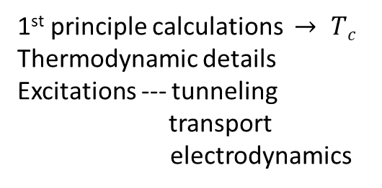
THEORIES OF SUPERCONDUCTIVITY
Phenomenological
Thermodynamics
Gorter-Casimir (two fluid)
London
Pippard
Ginzburg-Landau
Gorkov - Eliashberg (TDGL = Time-Dependent G-L)
Microscopic
BCS
+ Anderson
+ Bogoliubov
+ Midgal
Unconventional SC models
Which is right?
Gorkov
Which are useful?
macroscopic problems (E&M)
spatial variations (intermediate/mixed state)
current applied
macroscopic quantum phenomena
1st principle calculations $→ Tc$
Thermodynamic details
Excitations --- tunneling transport
electrodynamics
For superconductor device physics and quantum information applications? need some of both

Slide 3


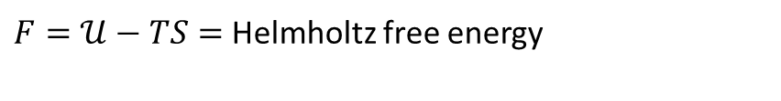
Phenomena --- what were experiments saying?
SC was new (and unusual) – perfect conductivity and perfect diamagnetism
Sharp and reversible onset with temperature and magnetic field and current
New phase of matter with a phase transition
THERMODYNAMICS
which thermodynamic energy is appropriate?
Compare “energy” of $N$ and $S$states $⟹$
$𝒰=$internal energy
OK for isolated systems
OK for
$\overset{⃑}{B}=$constant
$F=𝒰−TS=$Helmholtz free energy
Must account for energy from field source since $\overset{⃑}{B}$ changes at transition (Meissner effect)
$G=𝒰 −TS − PV− \overset{⃑}{H}∙\overset{⃑}{M}$ = Gibbs free energy
Compare $N$ and $S$ for same applied field and require that
$G_{N}= G_{S}$ at the phase transition (i.e. at T_{c} or H_{c})

Slide 4










THERMODYNAMICS
$$d𝒰=dQ −W$$
1ST Law of Thermodynamics
internal energy
heat input
work done BY system
$$dQ=TdS$$
2nd Law of Thermodynamics (quasistatic)
$S$= entropy
$$W=PdV −HdM$$
$H_{ }$= applied magnetic field
$$dU=TdS −PdV+H_{ }dM$$
$$G=𝒰−TS+PV−H_{ }M$$
$$dG= d𝒰 −TdS −SdT+PdV+VdP −H_{ }dM −MdH_{ }$$
$$dG=−SdT+VdP −MdH_{ }$$
$$dG=−MdH_{ }$$
constant $T,P$

Slide 5

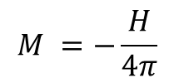



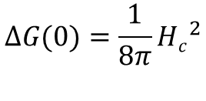






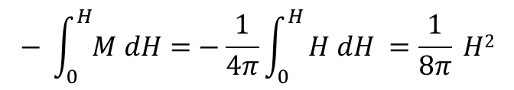





What do we know?
(1) Normal state: ${ G}_{N}\left(H\right)= G_{N}(0)$ independent of magnetic field for a non-magnetic material
(2) Phase transition: $G_{N}\left(H_{c}\right)= G_{S}(H_{c})$
$$− \int_{0}^{H}{M dH=}−\frac{1}{4π}\int_{0}^{H}{H dH =\frac{1}{8π} H2}$$
(3) Superconducting state: $G_{S}\left(H\right)− G_{S}\left(0\right)=$
$$M =−\frac{H}{4π}$$
perfect diamagnetism
$$G$$
$$G_{s}$$
$$dG=−MdH_{ }$$
$$G_{N}$$
$$∆G\left(H\right)= G_{N}\left(H\right)−G_{s}\left(H\right)$$
$$=\left[G_{n}\left(0\right)−G_{s}\left(0\right)\right]−\frac{1}{8π}H^{2}$$
$$∆G$$
$$=\frac{1}{8π}\left(H_{c}^{2}−H^{2}\right)$$
$$S$$
$$N$$
$$H$$
$$H_{c}$$
Depends on T
$$ΔG(0)=\frac{1}{8π}{Hc}^{2}$$
= $\frac{1}{2}{μ_{o}Hc}^{2}$ in MKS units
“Condensation energy” (stabilization energy)
SC is a lower energy phase that is weakened by applying magnetic field --- costs energy to expel the field

Slide 6









Entropy
for constant
$$p,H$$
Independent of field
$$H_{c}$$
$$−\frac{{∂H}_{c}}{∂T}$$
$$∆S$$
$$T$$
$$T_{c}$$
$$T$$
$$T$$
$$T_{c}$$

Slide 7









Normal state: $S_{N}\left(T\right)= γT$
$$γ= \frac{2}{3}π^{2}N\left(0\right)k_{B}^{2}$$
(Sommerfeld constant)
Superconducting state: $S_{S}\left(T\right)=$ $S_{S}\left(T\right)− ∆S$
$$S$$
$$S_{N}$$
$$S_{S}$$
$$T$$
$$T_{c}$$
Comments: As $T→0$, $S→0$(for both states) as required by the 3rd law ⇒
$S_{S}< S_{N} ⇒ SC$is an ordered state $(BCS)$
Slope $\frac{∂S}{∂T}$ discontinuous at $T=Tc$

Slide 8






Latent heat (at transition)
$$H_{c}$$
1st Order
$$H$$
2nd Order
$$T$$
$$T_{c}$$
In zero magnetic field, no latent heat because the transition occurs at $T = T_{c}$, where $H_{c}=0$
In finite magnetic field for T<T_{c}(H), transition by an applied field or an increase in T gives a finite latent heat
1st order in finite field
2nd order phase transition in zero field
(1st derivative of $G$is discontinuous)
(1st derivative of $G$is continuous)

Slide 9





Specific Heat
- cubic
+linear
$+ linear$
$$T_{c}$$
$$T$$
$$∆C$$
$$− cubic$$
SC specific heat is higher

Slide 10











Normal state: $C_{N}\left(T\right)=aT+bT^{3}$
electrons
phonons
Superconducting state: $C_{S}\left(T\right)=$ $C_{N}\left(T\right)− ∆C$
$$C_{N}$$
$$C_{s}$$
$$C$$
$$T$$
$$T_{c}$$
Thermodynamic predictions:
Preview of BCS:
Linear at low $T$
Exponential at low $T ⇒$ energy gap
Cubic at higher $T$
Jump precisely determined by $BCS=1.43γT_{c}$
Jump at $T_{c}=\frac{1}{2π} \frac{H_{c}^{2}\left(o\right)}{T_{c}}$

Slide 11






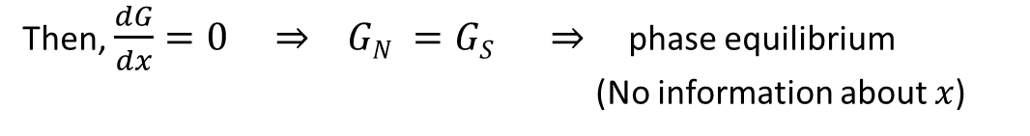




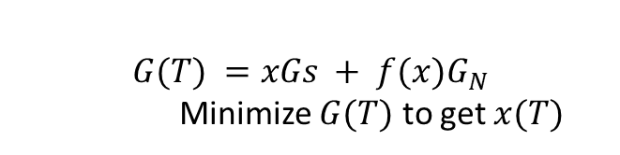
Two Fluid Model Gorter – Casimir (1934) (analogous to that in superfluid $He^{4}$, but preceded it)
Thermodynamics + two fluids T-dependences of measurable quantities: $G(T) ⇒S(T), C(T)$and $H_{c}(T)$
Order parameter = fraction of SC electrons
$$1$$
$$?$$
$$x$$
$$G(T) =xGS + f(x)G_{N}$$
Minimize $G(T)$ to get $x(T)$
$$T_{c}$$
NORMAL CARRIERS:
$$−\frac{∂G}{∂T}$$
$G_{N}\left(T\right)=−\frac{1}{2} γ T^{2}$ from $S=γT=$
SC CARRIERS:
$$GS\left(T\right)=−\frac{1}{8π} H_{c}^{2} (T)$$
1st guess: $G(T)= xGS(T)+(1−x)G_{N}\left(T\right)$
Then, $\frac{dG}{dx}=0 ⇒ GN =GS ⇒$ phase equilibrium
(No information about $x$)
2nd guess: $G\left(T\right)=xGS\left(T\right)+{{(1−x)}^{1/2}}^{ }G_{N}\left(T\right)$
Then, $\frac{dG}{dx}=0 ⇒ x=1 −{\left(\frac{GN}{2GS}\right)}^{2}=1 − \frac{{{(2πγ)}^{2} }^{ }}{H_{c}^{4}} T^{4}$

Slide 12
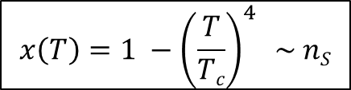
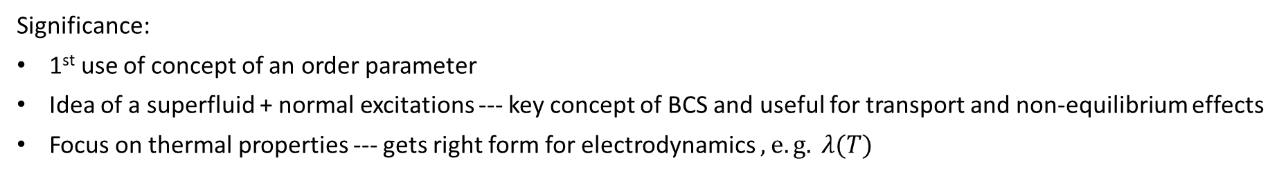
$$x\left(T\right)=1 −{\left(\frac{T}{Tc}\right)}^{4} \sim nS$$
Choose
so that
Then,
density of superconducting electrons
Calculate quantities:
Interesting model but not very justifiable
Significance:
1st use of concept of an order parameter
Idea of a superfluid + normal excitations --- key concept of BCS and useful for transport and non-equilibrium effects
Focus on thermal properties --- gets right form for electrodynamics $, e.g. λ(T)$

Slide 13
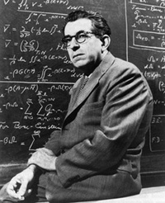
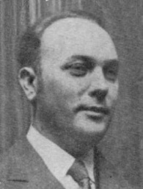


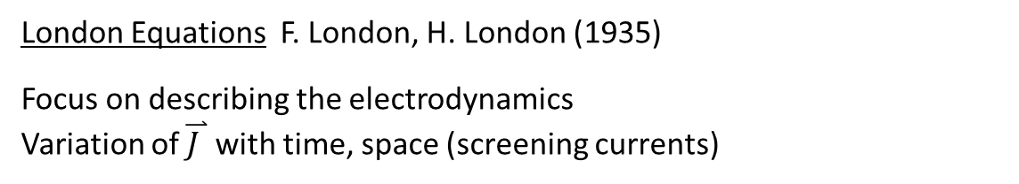



London Equations F. London, H. London (1935)
Focus on describing the electrodynamics
Variation of $\overset{⃑}{J }$with time, space (screening currents)
Return to the superconductor as a perfect conductor:
Fritz London
Forces:
$\overset{⃑}{F}=m\overset{⃑}{a}=m\frac{d\overset{⃑}{v}}{dt}$ = $e\overset{⃑}{E}→ \frac{d\overset{⃑}{v}}{dt}= \frac{e}{m} \overset{⃑}{E}$
$$\overset{⃑}{J}=ne\overset{⃑}{v} → \frac{d\overset{⃑}{J}}{dt}=ne\frac{d\overset{⃑}{v}}{dt}= \frac{{ne}^{2}}{m} \overset{⃑}{E}$$
$$\left(\frac{m}{{ne}^{2}}\right) \frac{d\overset{⃑}{J}}{dt}= \overset{⃑}{E}$$
Heinz London
1st London Equation
$Λ\frac{d\overset{⃑}{J}}{dt}$ =$\overset{⃑}{E}$
$$Λ= \frac{m}{{ne}^{2}}=$$
London Parameter

Slide 14

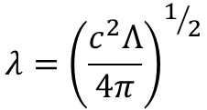

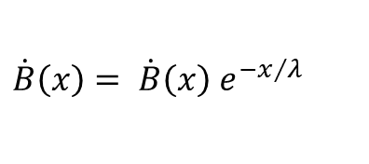










2. Magnetic Fields:
$$\overset{⃑}{∇}× \overset{⃑}{B}= \frac{4π}{c} \overset{⃑}{J}$$
1st London Equation
$$\overset{⃑}{∇} × \dot{\overset{⃑}{B}} = \frac{4π}{c} \dot{\overset{⃑}{J}}= \frac{4π}{cΛ} \overset{⃑}{E}$$
$$\overset{⃑}{∇} × \left(\overset{⃑}{∇}× \dot{\overset{⃑}{B}} \right)= \frac{4π}{c} \overset{⃑}{∇}×\dot{J}= \frac{4π}{cΛ} \overset{⃑}{∇}×\overset{⃑}{E}= \frac{4π}{c^{2}Λ} \dot{\overset{⃑}{B}}$$
$$Λ \left(\overset{⃑}{∇}×\dot{\overset{⃑}{J}}\right)= −\frac{1}{c} \dot{\overset{⃑}{B}}$$
$$⇒ ∇^{2} \dot{\overset{⃑}{B}}=+\frac{4π}{c^{2}Λ} \dot{\overset{⃑}{B}}$$
1-D geometry
$$\frac{d^{2}\dot{B}}{dx^{2}}= +\frac{4π}{c^{2}Λ} \dot{B}$$
$$\dot{B}$$
$$SC$$
Meissner effect $⇒\overset{⃑}{B}$
excluded
$$\dot{B}\left(x\right)= \dot{B}\left(x\right) e^{−x/λ}$$
2nd London Equation
$$Λ \overset{⃑}{∇}×\overset{⃑}{J}= −\frac{1}{c}\overset{⃑}{B}$$
$${λ=\left(\frac{c^{2}Λ}{4π}\right)}^{1/2}$$
$$x$$
$$\dot{B}$$
excluded from bulk (expected for perfect conductor)

Slide 15















LONDON EQUATIONS
$$\frac{d}{dt}\left(Λ\overset{⃑}{J} \right)= \overset{⃑}{E}$$
$$\frac{d}{dt}Λ\overset{⃑}{J}= \overset{⃑}{E}$$
$$cgs$$
$$Λ= \frac{m}{{ne}^{2}}$$
$$MKS$$
$$Λ= \frac{m}{{ne}^{2}}$$
$$\overset{⃑}{∇}×\left(Λ\overset{⃑}{J} \right)=−\frac{1}{c}\overset{⃑}{B}$$
$$\overset{⃑}{∇}×\left(Λ\overset{⃑}{J} \right)=− \overset{⃑}{B}$$
Can these be justified?
Start with the “canonical momentum”
$$\overset{⃑}{p}=m\overset{⃑}{v}+\frac{e}{c}\overset{⃑}{A}$$
We expect $\left\langle \overset{⃑}{p}\right\rangle =0$
in the ground state at zero field.
Assume same at finite field.
$$\left\langle v\right\rangle =−\frac{e}{mc}\overset{⃑}{A}$$
$$\overset{⃑}{J}=ne\left\langle v\right\rangle =−\frac{{ne}^{2}}{mc}\overset{⃑}{A}$$
$$Λ\overset{⃑}{J}=−\frac{1}{c}\overset{⃑}{A}$$
$$\frac{d}{dt}\left(Λ\overset{⃑}{J}\right)=−\frac{1}{c} \frac{d\overset{⃑}{A}}{dt}=\overset{⃑}{E}$$
London equations
$$\overset{⃑}{∇}×\left(Λ\overset{⃑}{J}\right)=−\frac{1}{c}\overset{⃑}{∇}×\overset{⃑}{A}=−\frac{1}{c}\overset{⃑}{B}$$

Slide 16




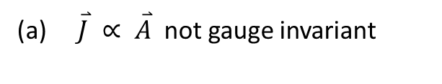





Comments:
(a) $\overset{⃑}{J} ∝ \overset{⃑}{A}$ not gauge invariant
Valid only for London gauge:
(
$$\overset{⃑}{∇}∙\overset{⃑}{A} =0=\overset{⃑}{∇}∙\overset{⃑}{J}=0$$
$$J_{⊥}=0$$
at surface)
(b) “Rigidity” of wavefunction
↔ electrons not affected by a magnetic field
(c) $\left\langle \overset{⃑}{p}\right\rangle =0$
suggests “condensation” into
$$\overset{⃑}{p}=0$$
state
$$⇒$$
Bose pairing of electrons
Corrections:
Going back to the “two-fluid picture: London equation applies only to the superfluid part
$$\overset{⃑}{J}⟶\overset{⃑}{J_{s}}$$
superfluid part only
Normal fluid:
$${\overset{⃑}{J}}_{n}=σ_{n}\overset{⃑}{E}$$
does not obey London
$$\overset{⃑}{E}⟶{\overset{⃑}{E}}^{′}=−\overset{⃑}{∇}φ=\overset{⃑}{E}−\frac{1}{e}\overset{⃑}{∇}μ$$
includes chemical potential
$$n⟶ns\left(T\right)$$
superfluid density

Slide 17







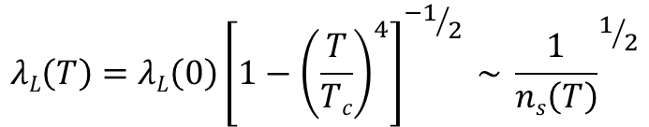





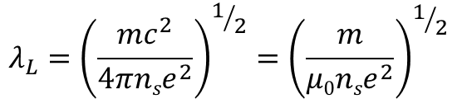



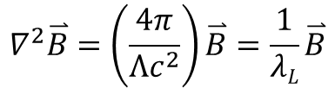


Applications
(1) Steady-state: ${\overset{⃑}{E}}^{′}=0$
$$B, J$$
(2) Field expulsion:
$$\overset{⃑}{∇}×\overset{⃑}{B}=\frac{4π}{c}\overset{⃑}{J}$$
$$B\left(x\right)=B0 e^{{−x}/{λL}}$$
$$Β0$$
$$∇^{2}\overset{⃑}{B}=\left(\frac{4π}{{Λc}^{2}}\right)\overset{⃑}{B}=\frac{1}{λL}\overset{⃑}{B}$$
$$J\left(x\right)=\frac{cB0}{4πλL} e{−x}/{λL}$$
$$λ_{L}={\left(\frac{{mc}^{2}}{4πnse^{2}}\right)}^{1/2}={\left(\frac{m}{μ0nse^{2}}\right)}^{1/2}$$
$$J0$$
$$x$$
$$cgs$$
$$MKS$$
$$λL$$
Superconductor
$$λL$$
Temperature dependence:
$$ns$$
50 nm
40 nm
85 nm
200 nm
NbTi 300 nm
65 nm
140 nm
YBCO (c) 700 nm
Al
Pb
$$λL\left(T\right)=λL\left(0\right){\left[1−{\left(\frac{T}{Tc}\right)}^{4}\right]}^{{−1}/2} \sim {\frac{1}{ns\left(T\right)}}^{1/2}$$
Nb
$$λL$$
PbBi
$$T$$
Nb₃Sn
$$Tc$$
YBCO (a,b)
Consistent w/ two-fluid model

Slide 18
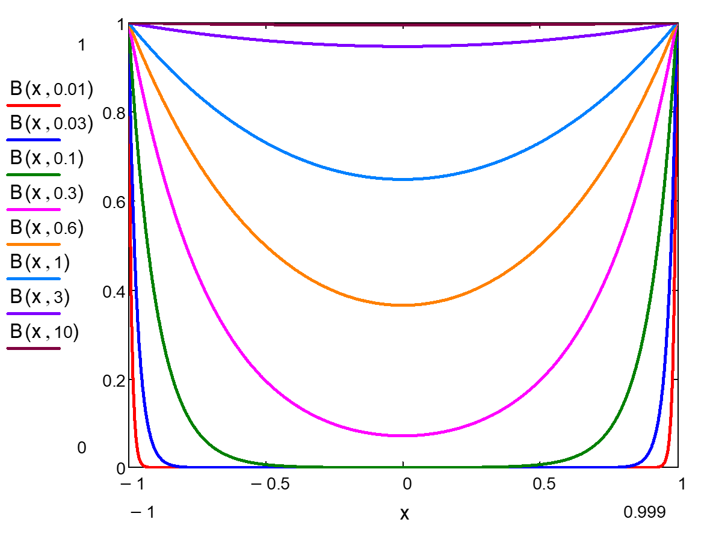
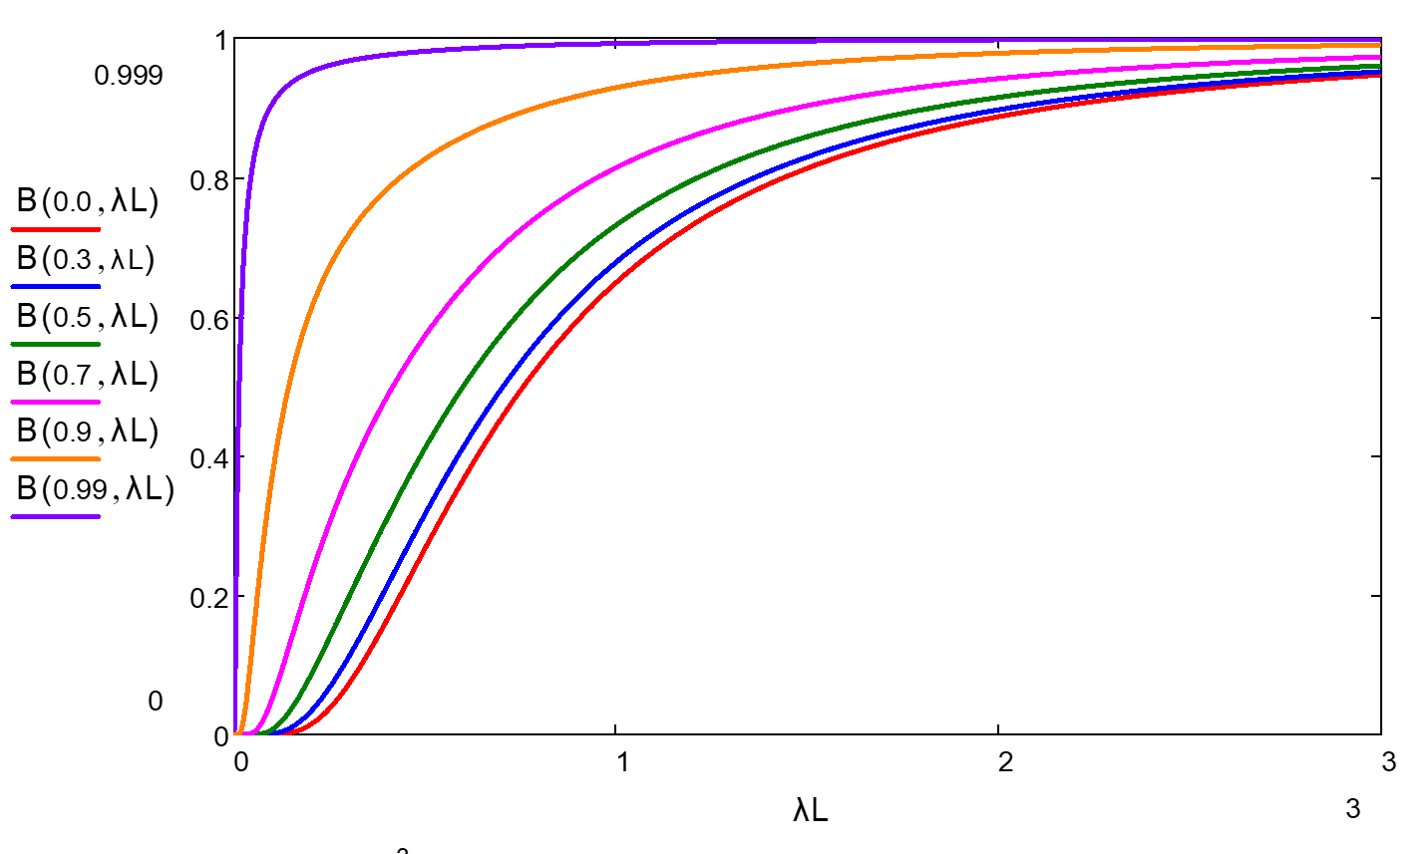

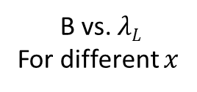


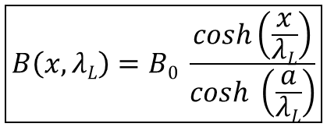






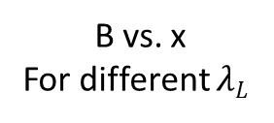
(3) Field applied to a finite thickness plate
$$B0$$
$$SC$$
$$B0$$
B vs. x
For different $λL$
$$−a$$
$$a$$
$$0$$
Width =
$$2a$$
$$\frac{d^{2}B\left(x,λL\right)}{dx^{2}}= \frac{1}{{λL}^{2}} B\left(x\right)$$
$$B\left(x,λL\right)={B_{1}e}^{−x/λL}+{B_{2}e}^{+x/λL}$$
B vs. $λL$
For different $x$
$$B.C. B\left(±a\right)=B0$$
$$\boxed{B\left(x,λL\right)=B0 \frac{cosh\left(\frac{x}{λL}\right)}{cosh \left(\frac{a}{λL}\right)}}$$

Slide 19









(4) Current flow in a strip
$$I$$
$$t$$
$$2a$$
$$J=\frac{I}{2at}$$
(a) Current density (uniform):
But this will be modified to prevent field penetration into the sample
$$B$$
$$x$$
$$x$$
$$−a$$
$$+a$$
Self-fields from currents will be screened by SC

Slide 20




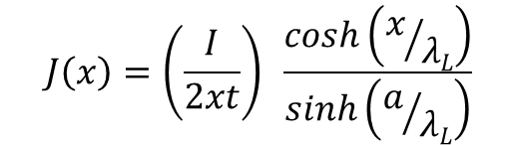





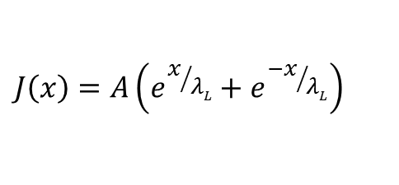







(b) Self-consistent London solution
$$(t≪a)$$
Solve for current flow
$$J\left(x\right)$$
:
$$∇^{2}J=\frac{1}{{λL}^{2}} J\left(x\right)$$
$$J$$
$$λL≪a$$
$$J\left(x\right)=A\left(e^{x/{λL}}+e^{{−x}/{λL}}\right)$$
$$λL\sim a$$
$$I=\int_{−a}^{a}{J\left(x\right)} tdx$$
current conservation
$$λL≫a$$
$$J\left(x\right)=\left(\frac{I}{2xt}\right) \frac{cosh\left(x/{λL}\right)}{sinh\left(a/{λL}\right)}$$
$$x$$
$$B$$
$$λL≪a$$
For
$$λ≫a, J\left(x\right)→ \frac{I}{2at}$$
uniform
$$λL \sim a$$
$$x$$
For
$$λL≪a, J\left(x\right)→$$
current piles up on edge
$$λL ≫a$$

Slide 21





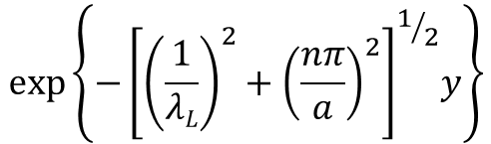

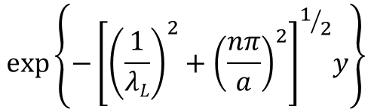



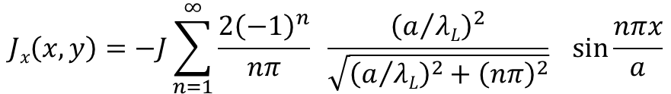



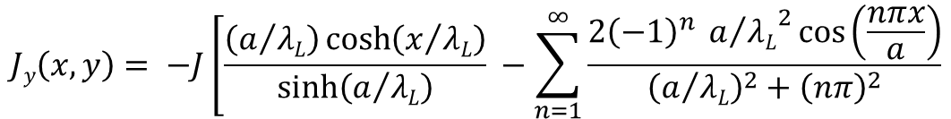
(5) Current flow at N-S interface
$$N$$
$$S$$
$$x$$
$$2a$$
$$y$$
2-D problem inside
$$S$$
$$∇^{2} Jx=\frac{1}{{λL}^{2}} Jx$$
$$∇^{2} Jy=\frac{1}{{λL}^{2}} Jy$$
Boundary conditions:
Current constraint:
$$Jx\left(y→∞\right)→0$$
$$I=\int_{−a}^{a}{Jy\left(x\right) t dx=2a t J}$$
$$\overset{⃑}{Δ}∙\overset{⃑}{J}=0= \frac{dJx}{dx}+\frac{dJy}{dy}$$
$$Jy\left(y=0\right)=JN$$
$$Jx\left(x,y\right)=−J\sum_{n=1}^{∞}{\frac{{2\left(−1\right)}^{n}}{nπ}} \frac{{\left(a/{λL}\right)}^{2}}{\sqrt{{\left(a/{λL}\right)}^{2}+{\left(nπ\right)}^{2}}} sin\frac{nπx}{a}$$
$$exp\left\{{−\left[{\left(\frac{1}{λL}\right)}^{2}+{\left(\frac{nπ}{a}\right)}^{2}\right]}^{1/2}y\right\}$$
$$Jy\left(x,y\right)= −J\left[\frac{\left(a/{λL}\right)\cosh\left(x/{λL}\right)}{sinh\left(a/{λL}\right)}\right. −\sum_{n=1}^{∞}{\frac{{2\left(−1\right)}^{n} {a/{λL}}^{2}cos\left(\frac{nπx}{a}\right)}{{\left(a/{λL}\right)}^{2}+{\left(nπ\right)}^{2}}}$$
$$exp\left\{{−\left[{\left(\frac{1}{λL}\right)}^{2}+{\left(\frac{nπ}{a}\right)}^{2}\right]}^{1/2}y\right\}$$

Slide 22
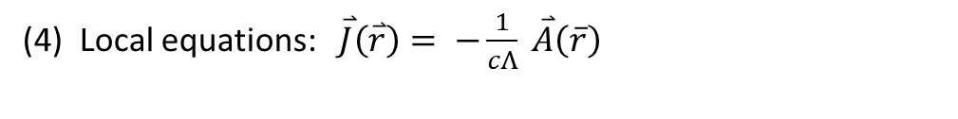


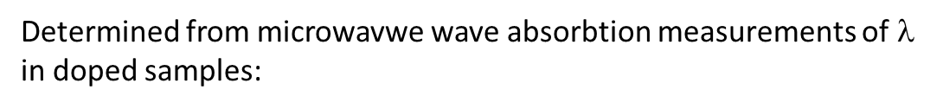

Beyond London …..
limitations of the London equations:
(1) Describe superfluid response – must put in normal response separately$⇒$ two-fluid model
(2) Applies to weak magnetic fields $⇒$ cannot handle vortices, intermediate state, inhomogeneous materials, …
(3) Predicts no dependence on impurities (contradicts experiment)
Determined from microwavwe wave absorbtion measurements of$$
in doped samples:
$$$$
Sn + 3% In doubled$$
DIRTY
CLEAN
$$ℓ$$
(4) Local equations: $\overset{⃑}{J}\left(\overset{⃑}{r}\right)= −\frac{1}{cΛ} \overset{⃑}{A}\left(\overline{r}\right)$

Slide 23
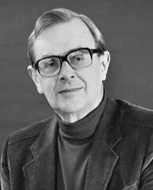

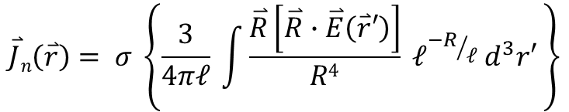



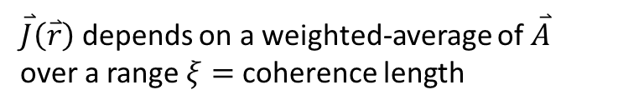
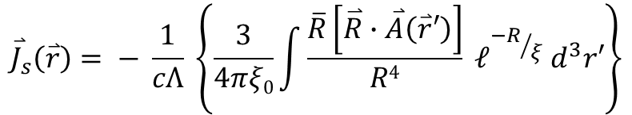






Pippard Non-local Modification to $\overset{⃑}{J}\left(\overset{⃑}{A}\right)$
Brian Pippard (Cambridge, 1953)
$\overset{⃑}{J}\left(\overset{⃑}{r}\right)$ depends on a weighted-average of $\overset{⃑}{A}$ over a range $ξ=$ coherence length
$$ξ$$
$$\overset{⃑}{r}$$
LONDON
$${\overset{⃑}{J}}_{s}\left(\overset{⃑}{r}\right)=− \frac{1}{cΛ} \overset{⃑}{A}\left(\overset{⃑}{r}\right)$$
$${\overset{⃑}{J}}_{s}\left(\overset{⃑}{r}\right)= − \frac{1}{cΛ} \left\{\frac{3}{4πξ0}\int{\frac{\overline{R}\left[\overset{⃑}{R}∙\overset{⃑}{A}\left(\overset{⃑}{r}′\right)\right]}{R4} }ℓ^{{−R}/ξ}{ d}^{3}r′\right\}$$
$$\overset{⃑}{R}$$
$$\overset{⃑}{R}=\overset{⃑}{r}′−\overset{⃑}{r}$$
PIPPARD
$$\overset{⃑}{r}$$
$$ο$$
$${\overset{⃑}{r}}^{′}$$
How did he get this form?
CHAMBERS expression for non-local resistivity
$$\overset{⃑}{J}n\left(\overset{⃑}{r}\right)= σ \left\{\frac{3}{4πℓ} \int{\frac{\overset{⃑}{R}\left[\overset{⃑}{R}∙\overset{⃑}{E}\left(\overset{⃑}{r}′\right)\right]}{R4} ℓ^{{−R}/ℓ} d^{3}r′ }\right\}$$
(replacing $\overset{⃑}{J}n\left(\overset{⃑}{r}\right)= σ\overset{⃑}{E}\left(\overset{⃑}{r}\right)$)
Here, range of influence is $ℓ$ due to memory over time between scattering events

Slide 24


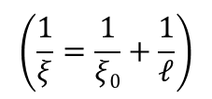







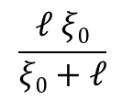










Range of non-locality for SC:
Values of$ξ0$
$ξ=$ Pippard coherence length
$$Al 1600 nm$$
$$Sn 230 nm$$
CLEAN SC ($ℓ>ξ0$)
DIRTY SC $\left(ℓ≪ξ0\right)$
$$Pb 83 nm$$
$$\frac{ℓ ξ0}{ξ0+ℓ}$$
$$Nb 38 nm$$
$$ξ=ξ0$$
$$ξ\left(ℓ\right)=$$
~ $ℓ$
$$PbBi 20 nm$$
$${Nb}_{3}Sn 4 nm$$
$$\left(\frac{1}{ξ}=\frac{1}{ξ0}+\frac{1}{ℓ}\right)$$
$$YBCO \left(a,b\right) 1.5 nm$$
$$YBCO \left(c\right) 0.4 nm$$
$$ξ$$
$$\sim ℓ$$
$$ξ0$$
$$ℓ$$
DIRTY
CLEAN

Slide 25






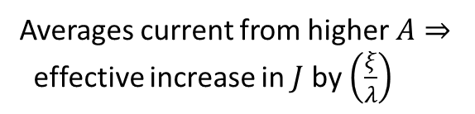

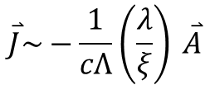
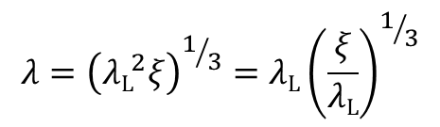

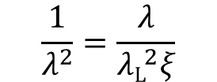


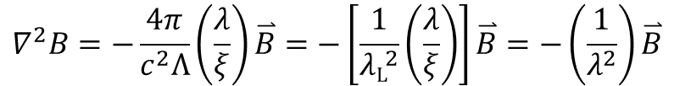
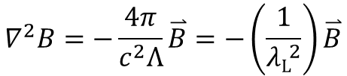

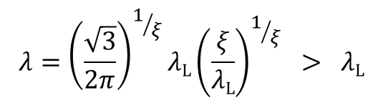


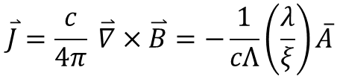


Non-locality:
$λ$vs. $ξ ⇒$LOCAL (London) vs. NON-LOCAL (Pippard)
$$A$$
$λ\text{L}$ > $ξ$
$$A$$
$λ\text{L}$ < $ξ$
$$ξ$$
$$ξ$$
Averages current from higher $A⇒$
effective increase in $J$ by $\left(\frac{ξ}{λ}\right)$
$$x$$
$$x$$
$$λ$$
$$λ$$
$$\overset{⃑}{J}=−\frac{1}{cΛ} \overset{⃑}{A}$$
$$\overset{⃑}{J}\sim −\frac{1}{cΛ}\left(\frac{λ}{ξ}\right) \overset{⃑}{A}$$
$$0.65$$
$$\overset{⃑}{J}=\frac{c}{4π} \overset{⃑}{∇}×\overset{⃑}{B}=−\frac{1}{cΛ}\overline{A}$$
$$\overset{⃑}{J}=\frac{c}{4π} \overset{⃑}{∇}×\overset{⃑}{B}=−\frac{1}{cΛ}\left(\frac{λ}{ξ}\right)\overline{A}$$
$$∇^{2}B=−\frac{4π}{c^{2}Λ}\left(\frac{λ}{ξ}\right)\overset{⃑}{B}=−\left[\frac{1}{{λ\text{L}}^{2}}\left(\frac{λ}{ξ}\right)\right]\overset{⃑}{B}=−\left(\frac{1}{λ^{2}}\right)\overset{⃑}{B}$$
$$\frac{1}{λ^{2}}=\frac{λ}{{λ\text{L}}^{2}ξ}$$
$$∇^{2}B=−\frac{4π}{c^{2}Λ}\overset{⃑}{B}=−\left(\frac{1}{{λ\text{L}}^{2}}\right)\overset{⃑}{B}$$
$$λ={\left(\frac{\sqrt{3}}{2π}\right)}^{1/ξ}λ\text{L}{\left(\frac{ξ}{λ\text{L}}\right)}^{1/ξ} > λ\text{L}$$
$$λ={\left({λ\text{L}}^{2}ξ\right)}^{1/3}=λ\text{L}{\left(\frac{ξ}{λ\text{L}}\right)}^{1/3}$$
$$λ =λ\text{L}$$
~$0.65$

Slide 26
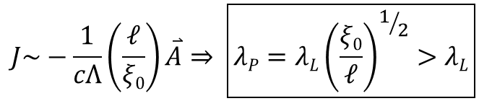

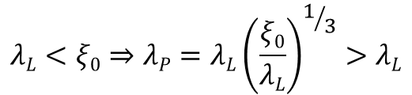








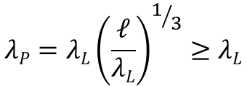

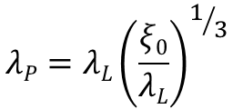
Non-locality over the coherence length modifies the penetration depth depending on the impurity concentration:
In CLEAN LIMIT, can be either London or Pippard limit:
LONDON
$$λL>ξ0⇒λP=λL$$
$$λL<ξ0⇒λP=λL{\left(\frac{ξ0}{λL}\right)}^{1/3}>λL$$
PIPPARD
In moderately DIRTY limit
$$λP<ξ\sim ℓ <ξ$$
$$λP=λL{\left(\frac{ℓ}{λL}\right)}^{1/3}≥λL$$
PIPPARD SC
$$λP=λL{\left(\frac{ξ0}{λL}\right)}^{1/3}$$
$$λ$$
$$ξ0>λL$$
LONDON SC
In very DIRTY limit
$$ξ\sim ℓ <λL,ξ0$$
$$ξ0<λL∟$$
$$λL$$
Always in London (local) limit
$$ℓ$$
DIRTY
CLEAN
Pippard expression: $ℓ^{−R/ξ}⇒ ℓ^{−\frac{R}{ℓ}}$
$$ξ0$$
$$J\sim −\frac{1}{cΛ}\left(\frac{ℓ}{ξ0}\right)\overset{⃑}{A}⇒ \boxed{λP=λL{\left(\frac{ξ0}{ℓ}\right)}^{1/2}>λL}$$

